Slide 1
Visualizing Information
Beaverworks 2021
Serious Games with AI
Notes:
Check distro statement before using:
DISTRIBUTION STATEMENT A. Approved for pubic release: distribution is unlimited.
This material is based upon work supported under Air Force Contract No. FA8721-05-C-0002 and/or FA8702-15-D-0001. Any opinions, findings, conclusions or recommendations expressed in this material are those of the author(s) and do not necessarily reflect the views of the U.S. Air Force.
© 2021 Massachusetts Institute of Technology.
Delivered to the U.S. Government with Unlimited Rights, as defined in DFARS Part 252.227-7013 or 7014 (Feb 2014). Notwithstanding any copyright notice, U.S. Government rights in this work are defined by DFARS 252.227-7013 or DFARS 252.227-7014 as detailed above. Use of this work other than as specifically authorized by the U.S. Government may violate any copyrights that exist in this work.

Slide 2
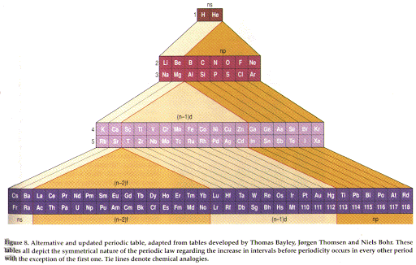
What are we looking at?
Notes:
Check distro statement before using:
DISTRIBUTION STATEMENT A. Approved for pubic release: distribution is unlimited.
This material is based upon work supported under Air Force Contract No. FA8721-05-C-0002 and/or FA8702-15-D-0001. Any opinions, findings, conclusions or recommendations expressed in this material are those of the author(s) and do not necessarily reflect the views of the U.S. Air Force.
© 2021 Massachusetts Institute of Technology.
Delivered to the U.S. Government with Unlimited Rights, as defined in DFARS Part 252.227-7013 or 7014 (Feb 2014). Notwithstanding any copyright notice, U.S. Government rights in this work are defined by DFARS 252.227-7013 or DFARS 252.227-7014 as detailed above. Use of this work other than as specifically authorized by the U.S. Government may violate any copyrights that exist in this work.

Slide 3
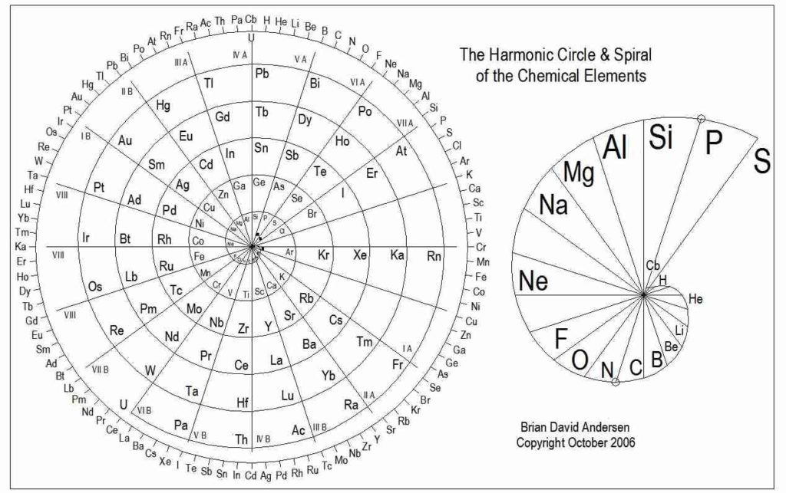
Or this?

Slide 4
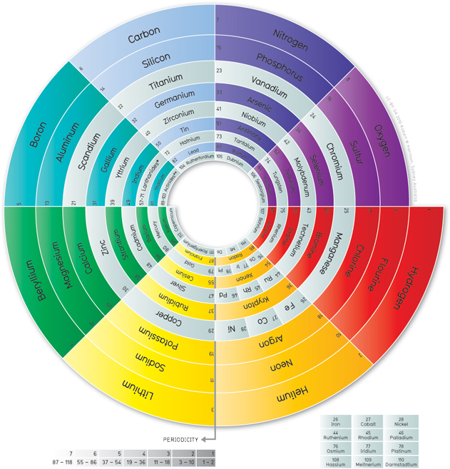
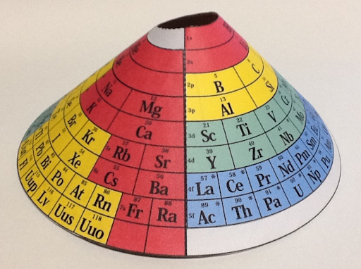
Or Even This

Slide 5
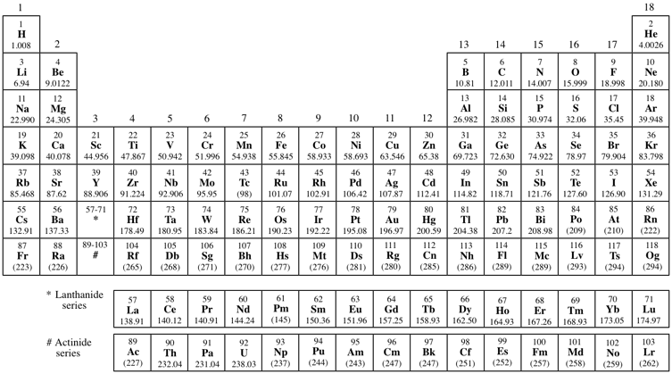
Information Does Not Have to be Flat

Slide 6
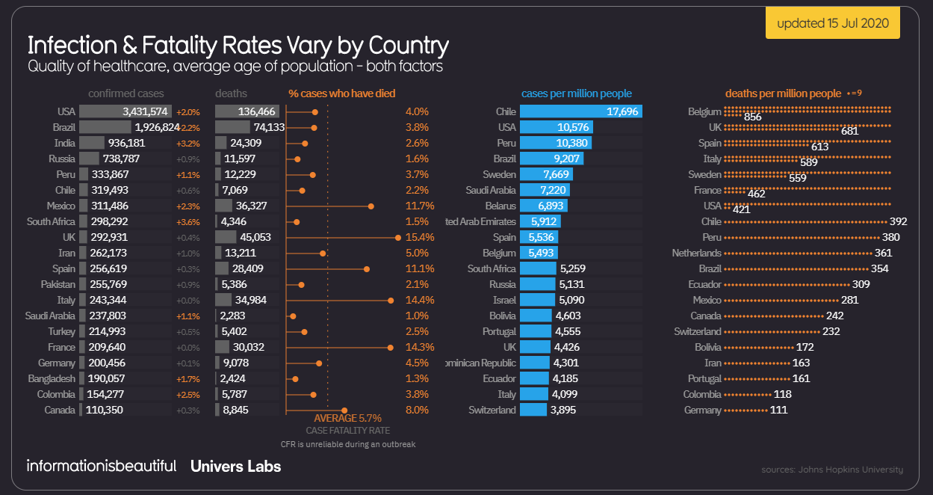
A Picture Is Worth…
Notes:
https://informationisbeautiful.net/visualizations/covid-19-coronavirus-infographic-datapack/

Slide 7
Scalar vs. Vector
Scalars are quantities that are fully described by a magnitude alone
Vectors are quantities that are fully described by both a magnitude and a direction
But unless you’re dealing with a single value, and not comparing it to anything, it makes sense to consider if there is a way to present the information graphically
Q2:
1, 1
2, 9
3, 7
4, 2
5,11
6, 4
7, 15
8, 4
9, 4
10, 12
11, 0
12, 10
Notes:
Which of the 12 principles do you think are more applicable to your goal of developing a mod to our Serious Game?

Slide 8
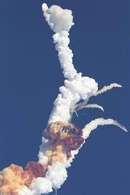
The Challenger Disaster
The Space Shuttle Challenger disaster was a fatal incident in the United States space program that occurred on Tuesday, January 28, 1986, when the Space Shuttle Challenger broke apart 73 seconds into its flight, killing all seven crew members aboard. The crew consisted of five NASA astronauts, and two payload specialists. The mission carried the designation STS-51-L and was the tenth flight for the Challenger orbiter.
The spacecraft disintegrated over the Atlantic Ocean, off the coast of Cape Canaveral, Florida, at 11:39 a.m. EST. The disintegration of the vehicle began after a joint in its right solid rocket booster failed at liftoff.
The failure was caused by the failure of O-ring seals used in the joint that were not designed to handle the unusually cold conditions that existed at this launch.

Slide 9
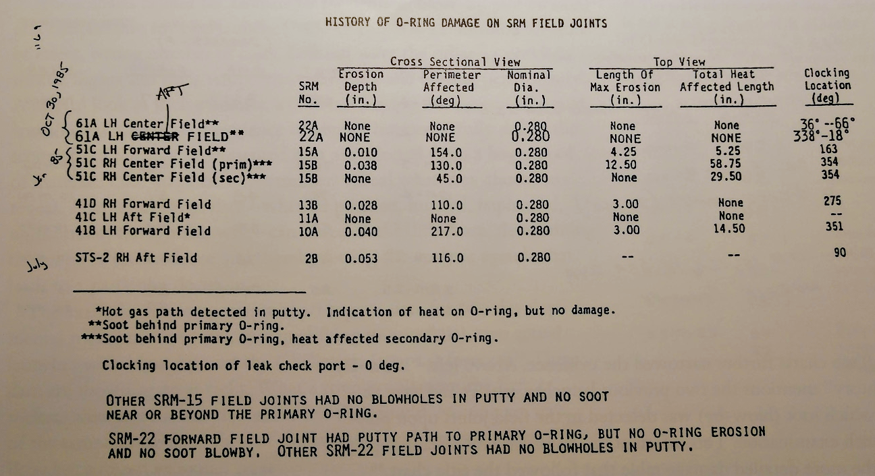
Show Me The Data

Slide 10
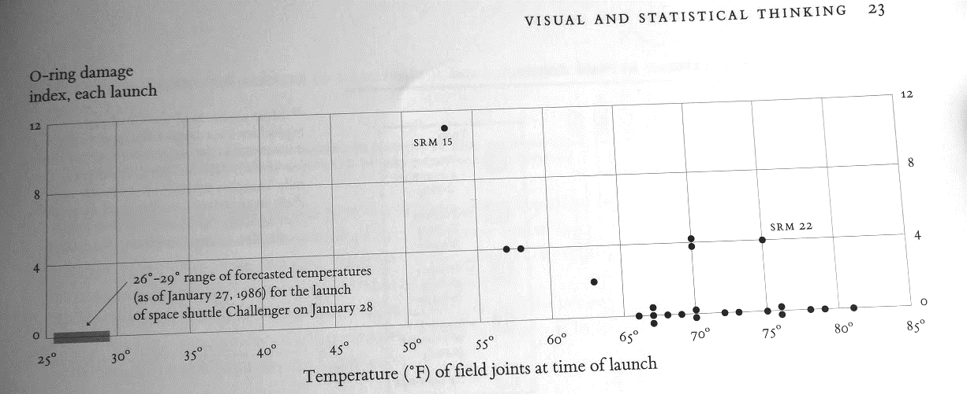
But Graphs Can Mislead

Slide 11
Conflating Factors
…the report also considered the contributing causes of the accident. Most salient was the failure of both NASA and Morton-Thiokol to respond adequately to the danger posed by the deficient joint design. Rather than redesigning the joint, they came to define the problem as an acceptable flight risk. The report found that managers at Marshall had known about the flawed design since 1977, but never discussed the problem outside their reporting channels
failures in communication ... resulted in a decision to launch 51-L based on incomplete and sometimes misleading information, a conflict between engineering data and management judgments, and a NASA management structure that permitted internal flight safety problems to bypass key Shuttle managers
The Challenger accident has frequently been used as a case study in the study of subjects such as engineering safety, the ethics of whistle-blowing, communications, group decision-making, and the dangers of groupthink. It is part of the required readings for engineers seeking a professional license in Canada and other countries

Slide 12
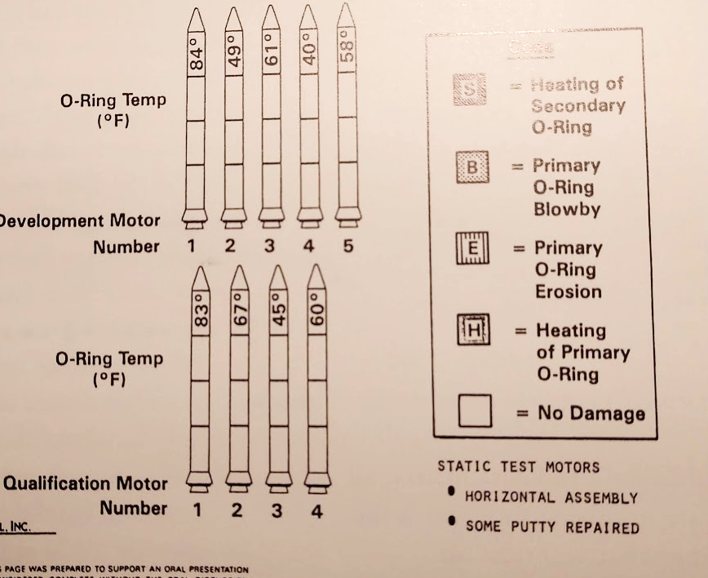
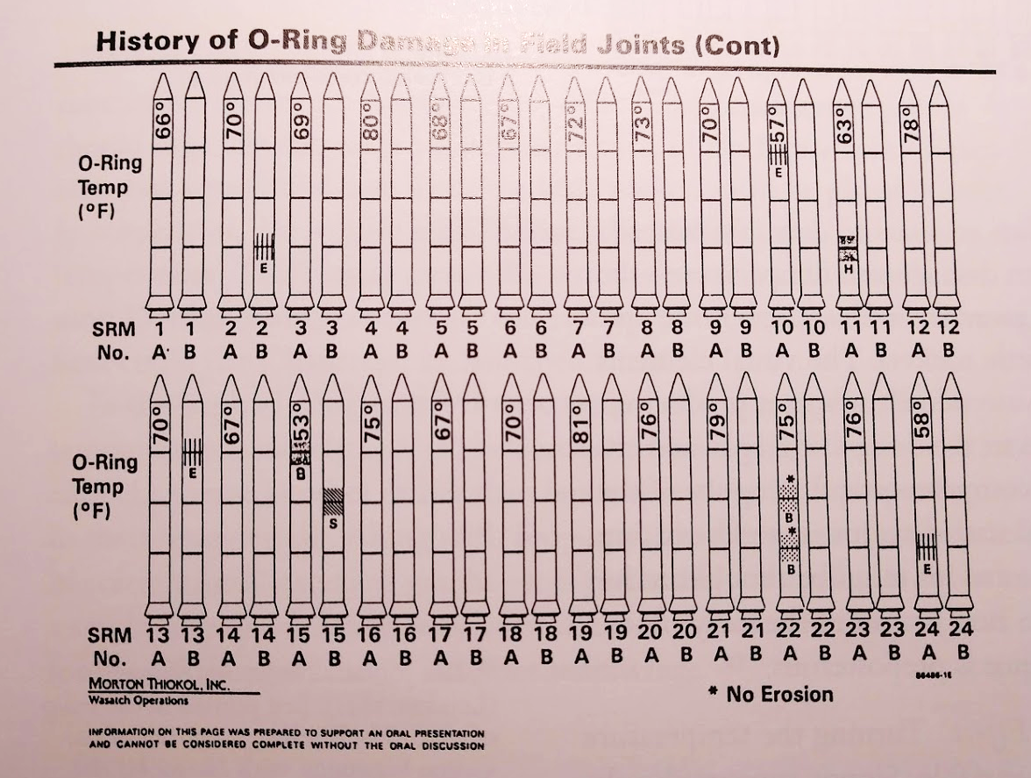

What Would Have Been Better?

Slide 13
When You Present Information Consider What Is the Most Important Message You Wish To Convey
In the case of the Challenger disaster the single most important factor was temperature
As such it is very important to:
Eliminate data that is not immediately relevant to your message
Ensure you distinguish clearly cause and effect – how does your graphic illustrate the relationship between the two
Make sure the order of entities on the graph or display makes sense – how are you choosing your axes and linear vs log
Don’t get fancy, often a simple scatterplot is more useful than icon-based eyecandy
You want to help the data speak for itself
In the best case the audience should be able to grok the message at a glance
If you need to, it doesn’t hurt to add a “bang box”, generally one sentence to underscore your message

Slide 14
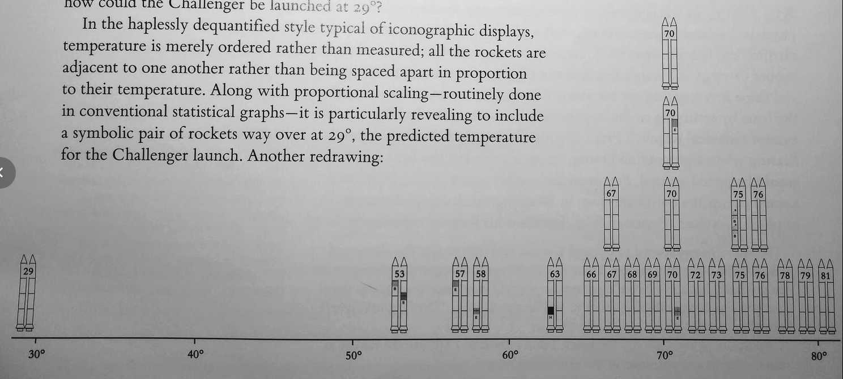
Is This Better?

Slide 15
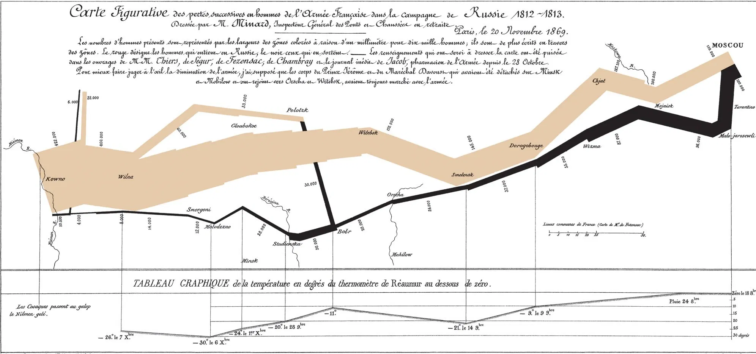
Show me the data
For technical presentations, showing data is essential
The challenge is often not just how to show data, but other factors, parameters, influences
Charles Minard's 1869 chart showing the number of men in Napoleon’s 1812 Russian campaign army, their movements, as well as the temperature they encountered on the return path.

Slide 16
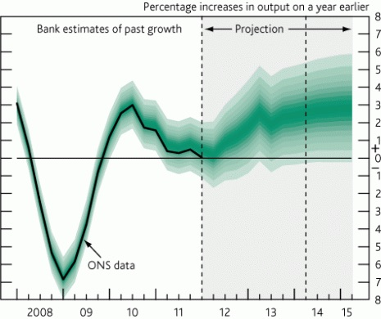
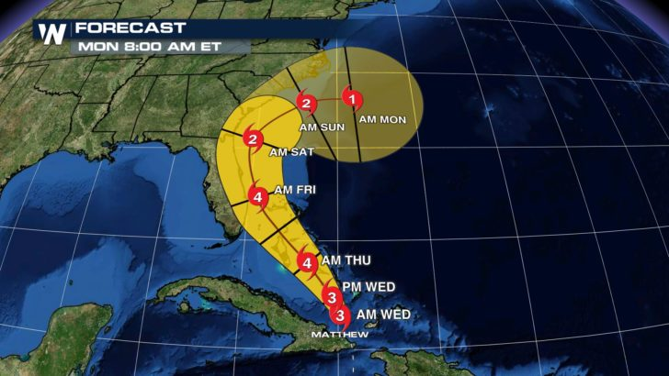
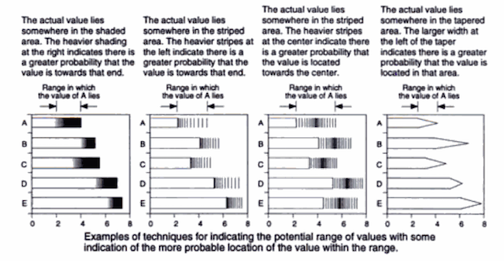
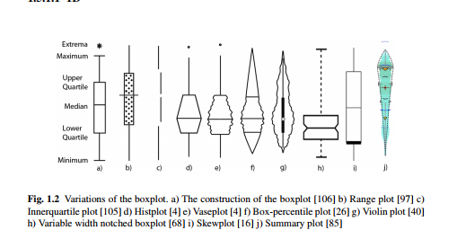
Visualizing Uncertainty
A critical component of display is communicating uncertainty to the user
A “visual metaphor” can help the user understand the associated probability
The challenge is to integrate uncertainty with controls on a user interface

Slide 17
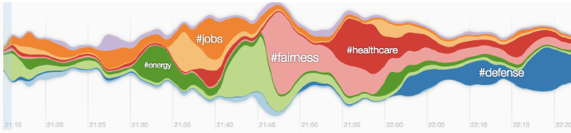

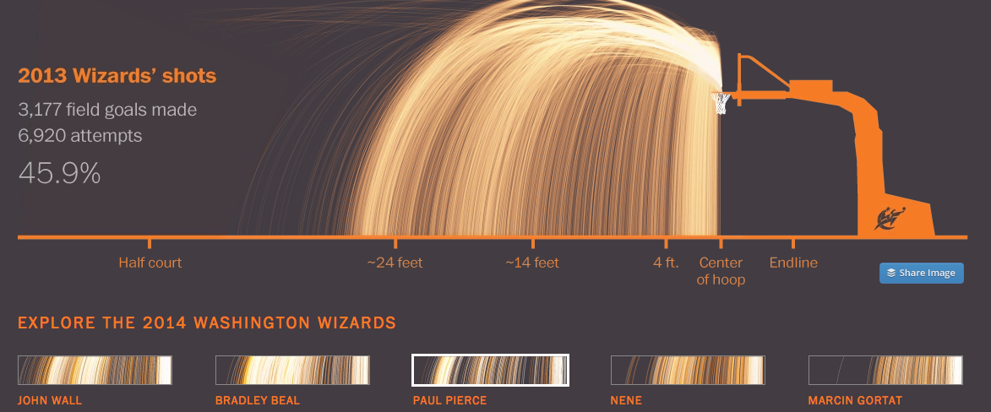
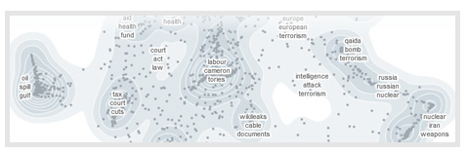
Reducing Visual Complexity Without Obscuring Detail
Visualizations can do more than cram more information into a single display, they can enhance the user experience
State of the Union address over time on Twitter
News Cloud: weighted/sorted attributes related to a topic
Weyeser Explorer: data cluster elevation map
Shooting success based on distance and player

Slide 18
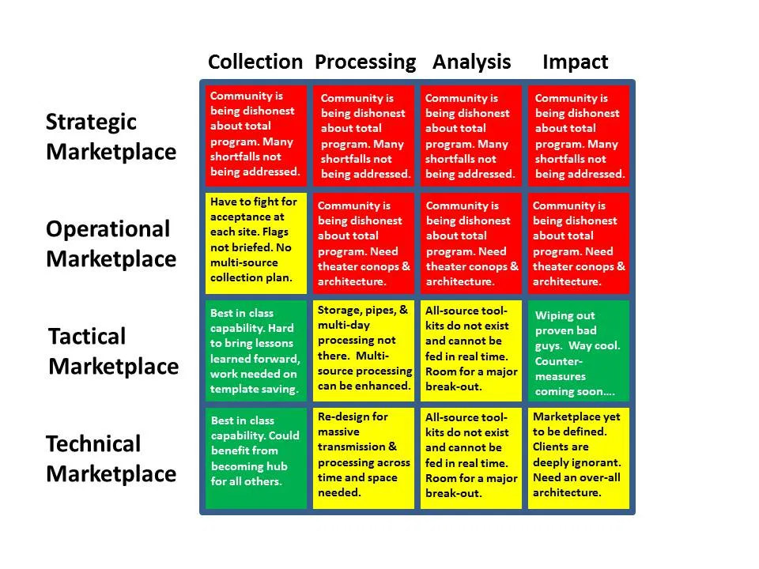
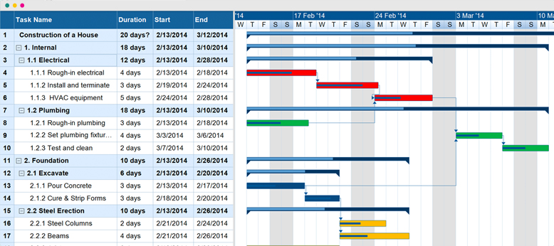
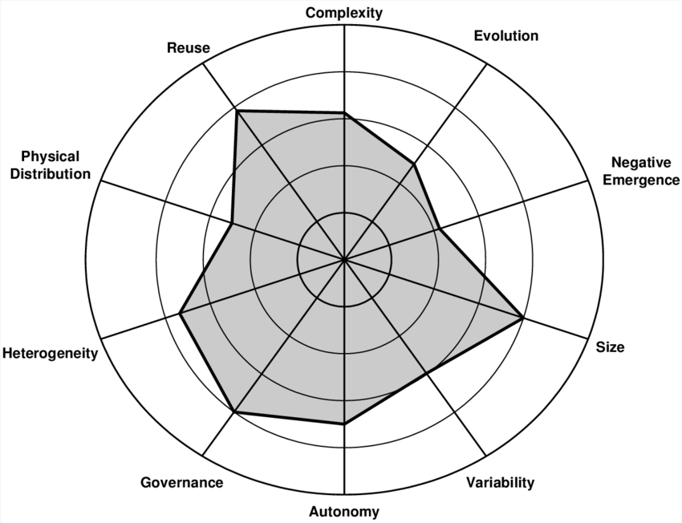
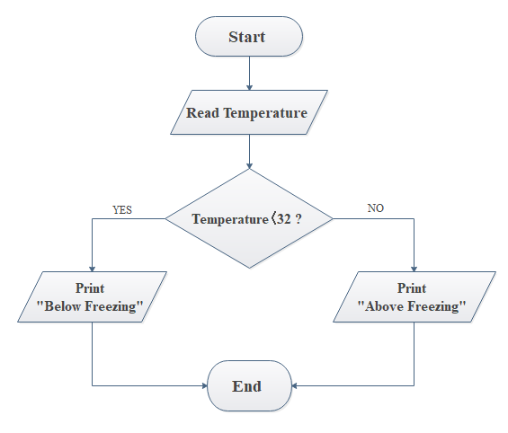
Some Common Chart Mechanisms
Stoplight Chart
Gantt Chart
Spider Chart
Flow Chart

Slide 19
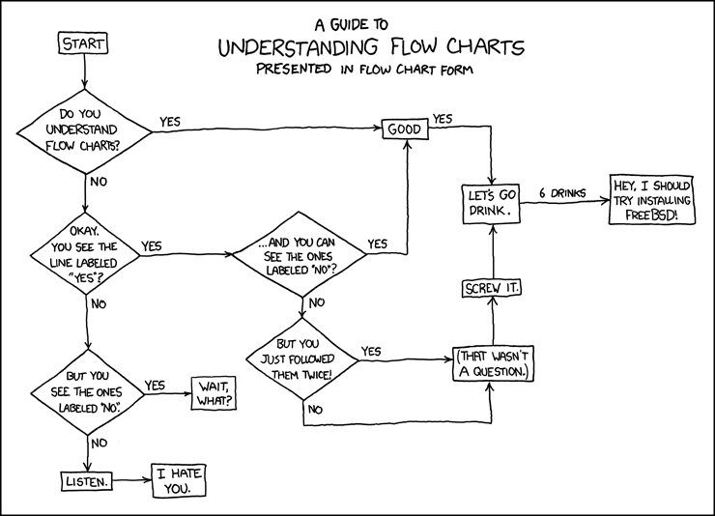
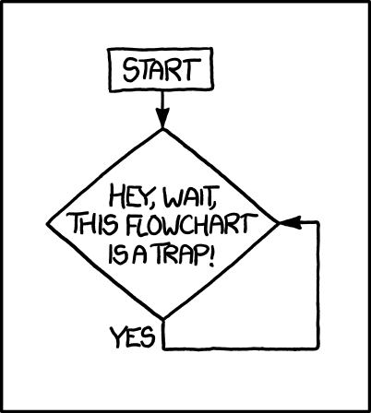
Indeed
Also this…
6 Lattes Later
Yeet it.

Slide 20
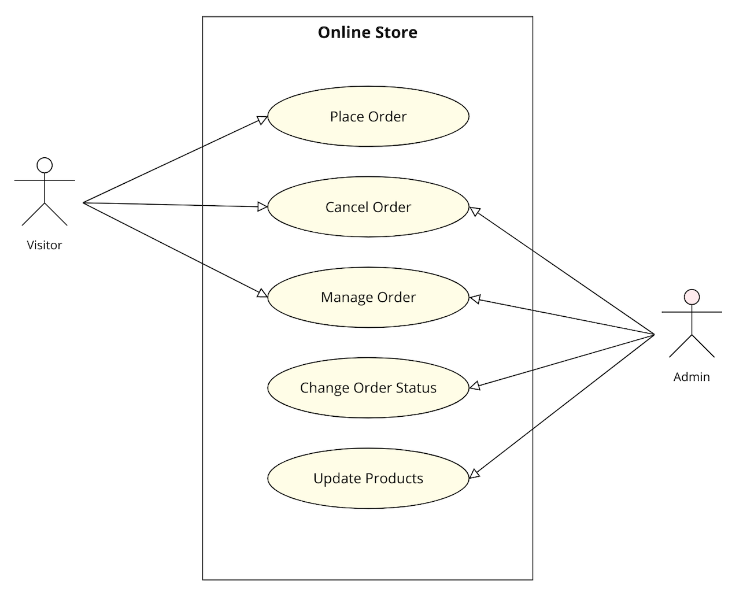
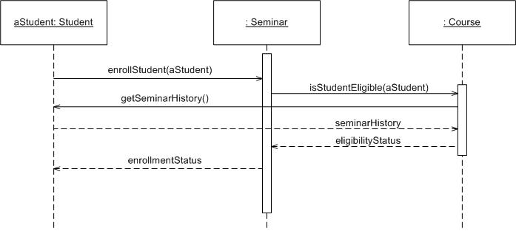
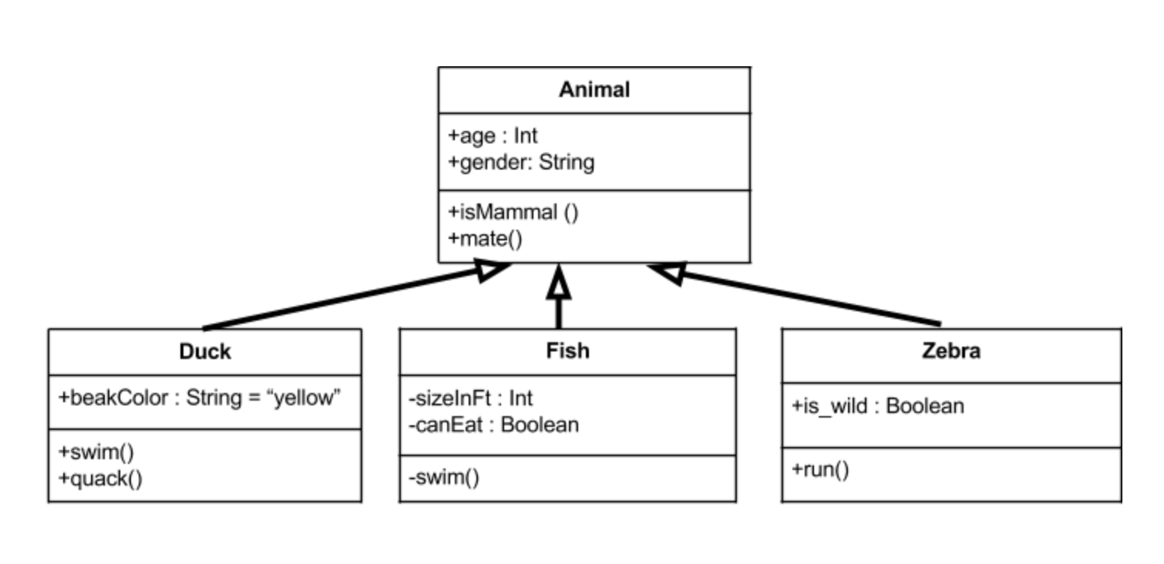
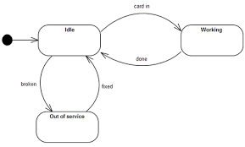
Some Common Software Diagram Mechanisms
Timing Diagram (Interaction)
Use Case Diagram (Behavior)
State Machine Diagram (Behavior)
Class Diagram (Structure)

Slide 21
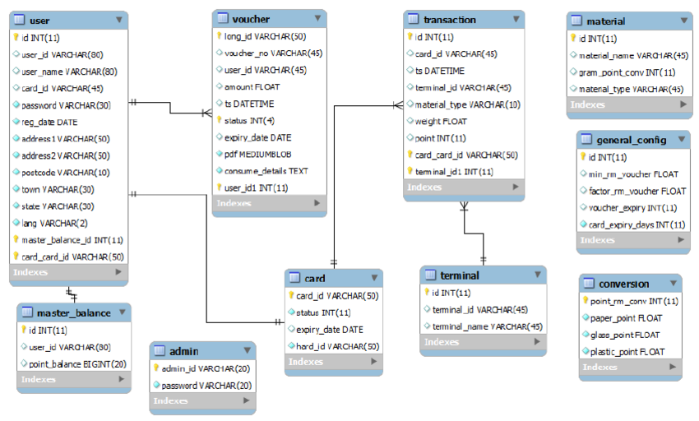
Unified Modeling Language
Unified Modeling Language – UML was developed in the 90’s coinciding with the development of Object Oriented Programming
It enables visualization of different architectural aspects of a body of code
UML is considered a standard by the International Organization for Standardization (ISO) - meaning it’s recognized universally as a way to represent software design
Being able to visualize the code provides a vehicle for conversation and to experiment with different ways of implementation
Tools exist to “reverse engineer” diagrams, meaning to create diagrams from existing code
Often it is easier to wrap your head around a visual representation than just the code itself
Database Modeling looks similar to Class Modeling but connections are keys into the tables

Slide 22
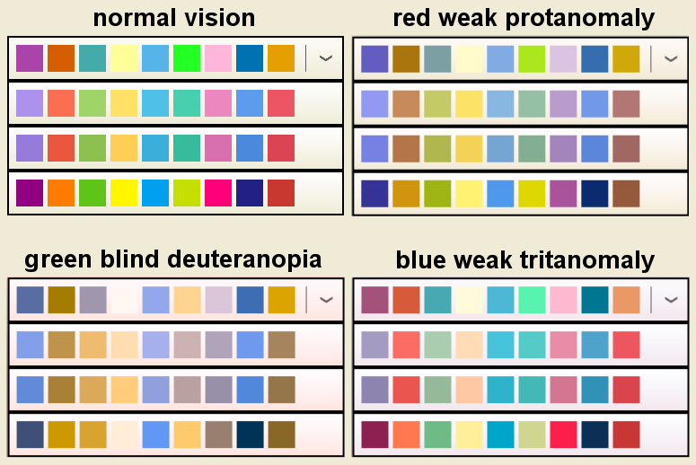
Impact of Color and Color Blindness
Red–green color blindness is the most common form, followed by blue–yellow color blindness and total color blindness
Red–green color blindness affects up to 8% of males and 0.5% of females of Northern European descent
While a relatively small percentage, it is necessary to consider the impact of color, instead use intensity, icons, shapes or other visual differentiators

Slide 23
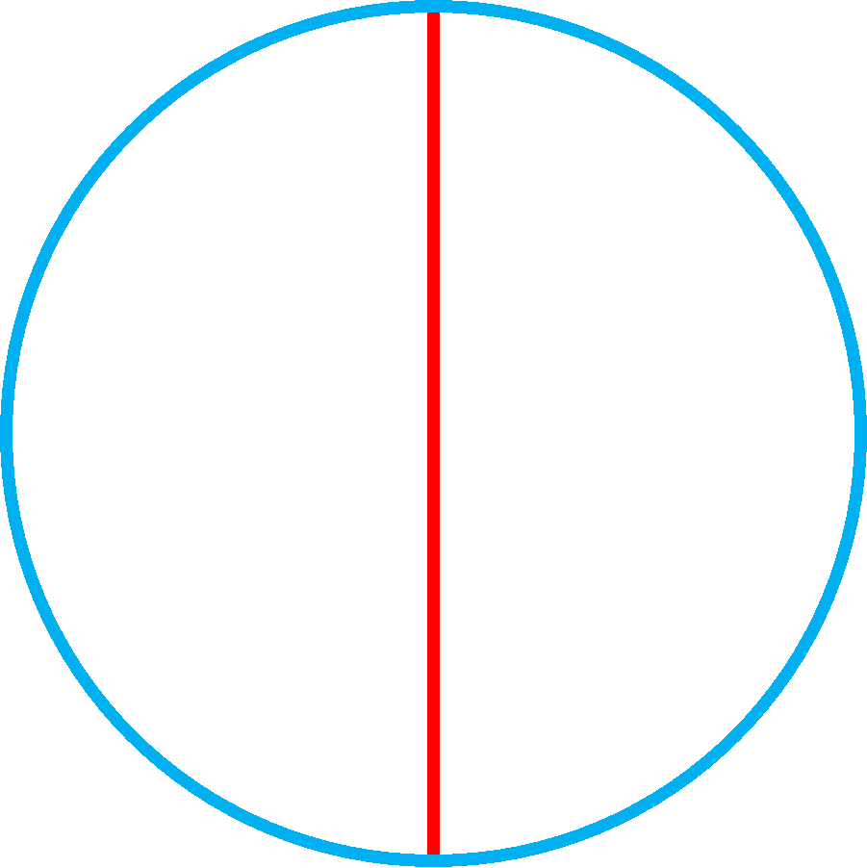
Animation
Animation should be applied sparingly
Animation is distracting, but showing an animation may be the most efficient means to explain something more complex
Modeling and Simulation may be represented as a Small Multiples instead
0.141…
d
1d
2d
3d

Slide 24
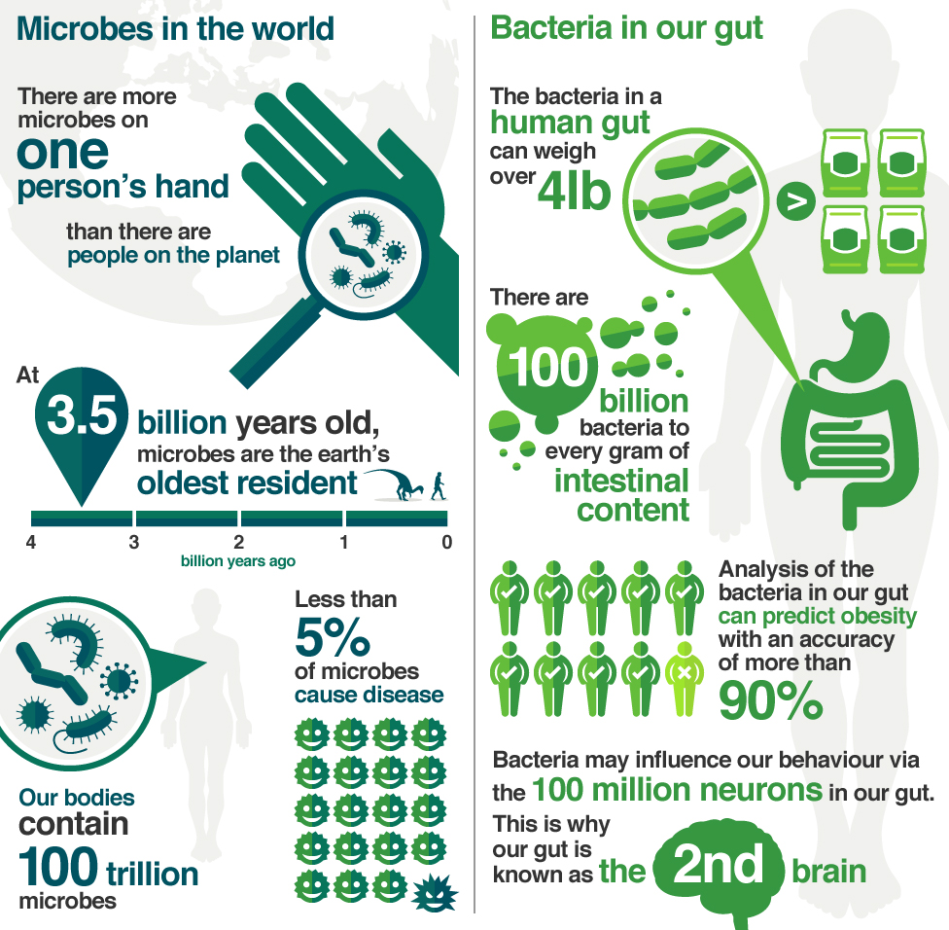
Infographics
Infographics ("information" and "graphics") are graphic visual representations of information, data, or knowledge intended to present information quickly and clearly
They improve understanding by using graphics to enhance the ability to see patterns and trends
Infographics generally require someone with a background in visual and information arts and right tools
Putting together an illustration such as this requires significant effort and collaboration between the illustrator and the scientist

Slide 25
Visualization is Powerful
Visualization of information, especially data, is a powerful tool for communication
Between technologists it enables communication and abstract thought without the boundaries and limitations of detailed description
Visualization can facilitate conversation and encourage people to speak up
In addition, graphics make information seem more accessible, which facilitates conversation with non-technologists
Images bridge the gap, allowing focus on the more abstract underlying concepts
Side note: used improperly, they can also reveal key things about the presenter…
1
The least powerful visualization of data that I’ve ever encountered
(reproduction)

Slide 26
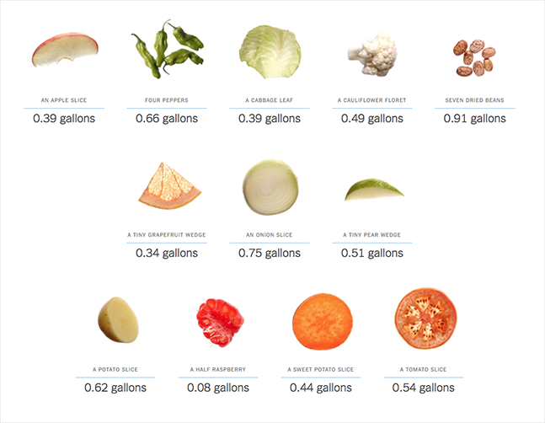
Infographic: Your Contribution to the California Drought By Larry Buchanan, Josh Keller, and Haeyoun Park

Slide 27


